Slide 1
Crypto App (Based on Web3)
Subham Maity - 43
Subhasish Negel - 44
Bikram Debnath - 18

Slide 2


Why should we use Blockchain?
Example
The shop looks like this – you pay first and then the guy hands you your stuff. You pay him for the instant noodles, and you find that the shopkeeper just sits back down on his chair and does nothing.
Me: “Give me the noodles!”
Shop owner: “Sure, that’ll be ₹20.”
Me: “I just paid you!”
Shop owner: “When? No, you didn’t.”
Other than calling the police or starting a fight, you would have no recourse.
The problem here was that you had to trust a human to do his part after you did yours.
While people generally do their part in an implied contract like this one (the contract here was “I give you the stuff after you pay me”), relying on humans, to be honest, is not an ironclad solution and people get cheated every once in a while.

Slide 3
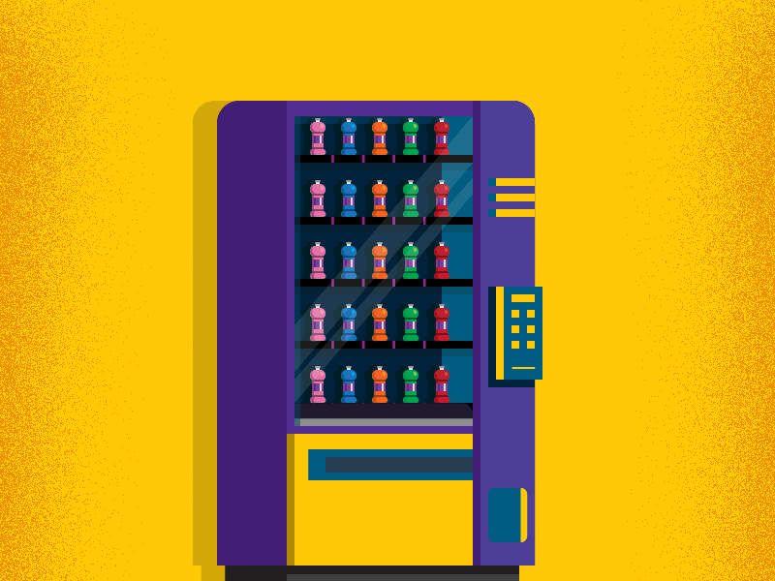
Why should we use Blockchain?
Then What is Smart Contract ?
Note: Smart contract is just a marketing term for computer
programs. It has absolutely nothing to do with a legal contract.
(Do not relate smart contracts with contracts in a legal sense.)
You want to use a system that takes your money and then gives you
what you want for sure (a type of contract where you don’t have to trust anybody).
Here, it would be a vending machine.
The vending machine is a real-world example of a smart contract.
In fact, smart contracts aren’t smart at all. They are just pieces of code that execute exactly as written. For example, if a well-known billionaire is extremely thirsty and offers to pay a million dollars for a drink, it would be smart to take it. But… the vending machine won’t take it, because it hasn’t been explicitly programmed to do so.
This piece of code is stored and executed in a distributed/decentralized manner (more on that later).
They are mainly used to reduce the need for a trusted intermediary, disputes, and frauds.

Slide 4

What is Blockchain Technology?
Blockchain is a distributed ledger that is a collection of records, called blocks, that are linked together by cryptography.
Example of Blockchain in Real Life
Let's say I purchase something from an offline store, and I have a ledger in which I can record the details of the purchase, and that ledger was created by the store. Now if the shopkeeper manipulates the ledger, I can't do anything.
But in the case of blockchain, Shopkeeper can't manipulate the ledger, because the ledger is linked to the blockchain, and it is immutable. If the shopkeeper tries to manipulate the ledger, you can easily find out someone is trying to tamper with the ledger, and you can easily stop him. Detailed Explain Here
Notes:
Document (subham-maity.github.io)

Slide 5

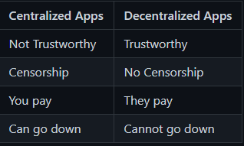
Why should you build a dApp over a regular app?
Zero downtime is guaranteed.
More Secure as the malicious actors cannot launch attacks like denial-of-service
on the individual dApps.
Offers absolute privacy as a dApp can be deployed and used without
requiring real-world identity verification.
Gives you greater control over the application.
Provides complete data integrity.

Slide 6
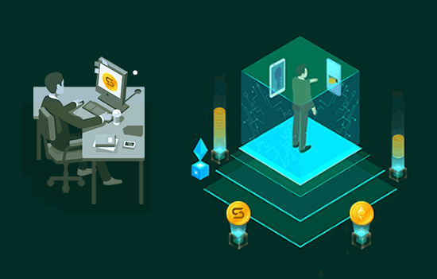
How does decentralized app work?
To use the decentralized apps, instead of downloading the application, the user has to pay a certain amount of gas(in terms of the cryptocurrency) to the developer.
The user can also download the source code of the application under a “smart contract”- a collection of code, logic, and data to run the application. Unlike centralized apps, the backend code of the decentralized application runs on the P2P network instead of the centralized servers.

Slide 7
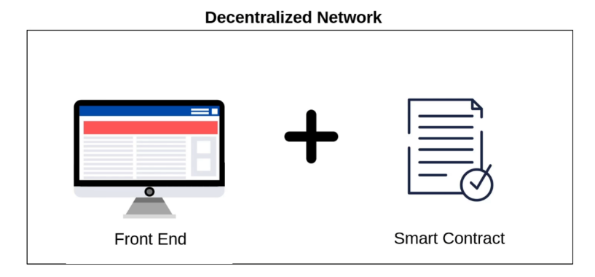
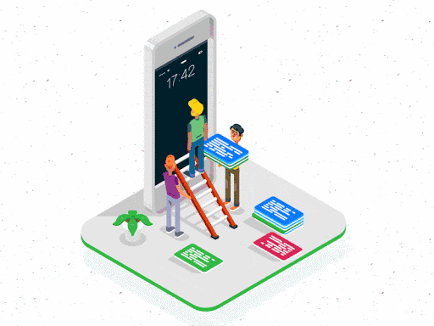
Blockchain Implementation
The development process of dApp is different than the centralized ones.
List the app requirements and check them for their feasibility.
Install the Node Package Manager.
Choose tech stack, including database, frameworks, hosting, frontend, its contracts, programing language, APIs, and Development server. We can use Ethereum for the same. (also Solana and another blockchain)
Launch an Initial Coin Offering to raise the funds that we will need to develop our project.
Build our dApp using the platforms like truffle.
Test our dApp and smart contract for its functionality.
Once tested successfully, we can launch the dApp on Web3.

Slide 8

What is our Crypto dApp?
This dApp is designed for normal users who want to send cryptocurrency to each other through an app, and the process will be extremely straightforward.
Normal people can also perform a large number of tasks on our web3 platform, which will assist them with investment tips, help them make investments more profitable with our artificial intelligence, and offer them a variety of features.
⦾ When you have cryptocurrency, simply connect your Metamask wallet to the Crypto dApp and you will be able to send the currency through our app.

Slide 9
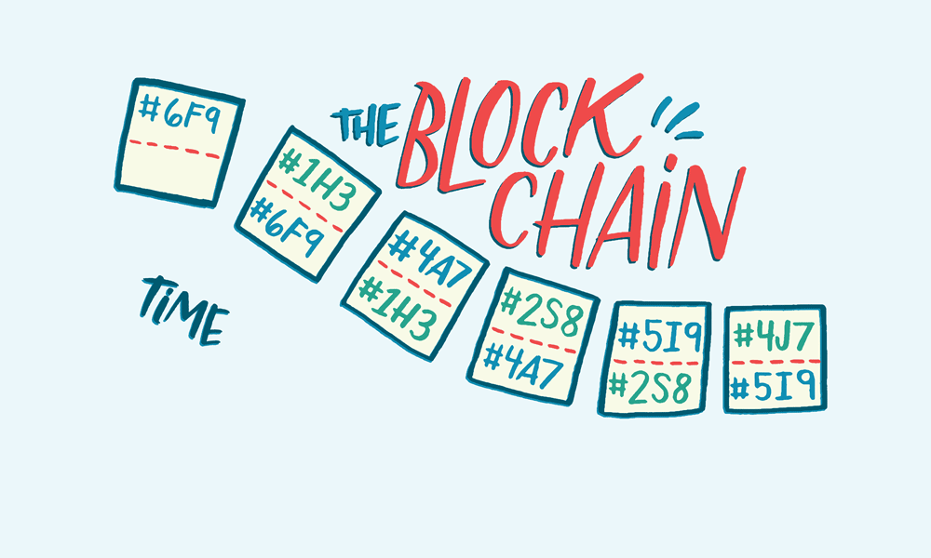
Our Frameworks for Blockchain Implementation
Frontend: ⭐ Using Rapid API ⭐ ReactJS and NodeJS ⭐ JS ⭐ HTML ⭐ CSS /Tailwind/Bootstrap
Backend Layer in Web3.0: ⭐ Solidity⭐ Rust⭐ Python⭐ Ethereum Blockchain⭐ Truffle ⭐ Web3.js⭐ JSON-RPC

Slide 10
Features
Blockchain Features
Sending ether or another cryptocurrency through our dApp using our Smart Contract (An Smart Automated Agreement between two Participants using Solidity Programming)
Anyone can check 18,465 Cryptocurrencies (all crypto in the world) price and all details about that crypto such as Price Chart(5years to 3hrs ago), Price to USD, Rank, Number Of Markets, Number Of Exchanges, Approved Supply, Total Supply, Circulating Supply, Market Cap,24h Volume, and Detailed about that crypto and their official websites.
3. Our goal is to provide real-time blockchain and Crypto market news to help users stay up-to-date on what's happening in the market so they can make an informed decision regarding whether to sell crypto or not for trading or anything else such as NFTs.

Slide 11

Machine Learning Features
Using Machine Learning, predict future crypto prices and know when to sell, reducing the risk for traders.
Help page with a chatbot that can assist the user with any doubts the user has about our service

Slide 12
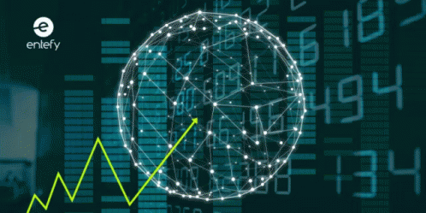
Importance of Stock Market
Stock markets help companies to raise capital.
It helps generate personal wealth.
Stock markets serve as an indicator of the state of the economy.
It is a widely used source for people to invest money in companies with high growth potential.

Slide 13
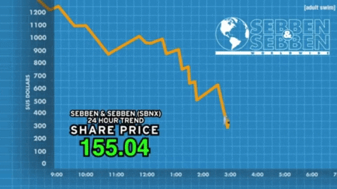
Why Predicting Stock Prices & is It Risky ?
According to experts’ Bitcoin price prediction, the price of BTC will reach $100,000 by the end of 2022, rising to $256,117 by the end of 2025 and $1,010,923 in 2030.
The entire idea of predicting stock prices is to gain significant profits. Cryptocurrency markets are highly volatile and your investments are at risk.

Slide 14
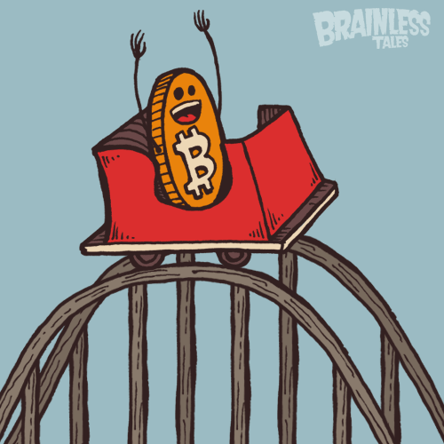
What Makes It So Risky ?
Predicting how the stock market will perform is a hard task to do. There are other factors involved in the prediction, such as physical and psychological factors, political situation, rational and irrational behaviour, and so on.
All these factors combine to make share prices dynamic and volatile. This makes it very difficult to predict stock prices with high accuracy.

Slide 15

What Tools We’re Using ?
For Time Series Data Visualisation we can use Plotly to create an interactive visual chart, by doing that we can check out and interact with the price history of cryptocurrency stock prices
For prediction we can use various types of ML algorithms like –
Linear Regression
ARIMA family of techniques
Prophet by Facebook
Support Vector Regression (SVR)
K Nearest Neighbor
Random Forest
Other than these ML based techniques, we can use various DL based techniques as well. After All, all are

Slide 16
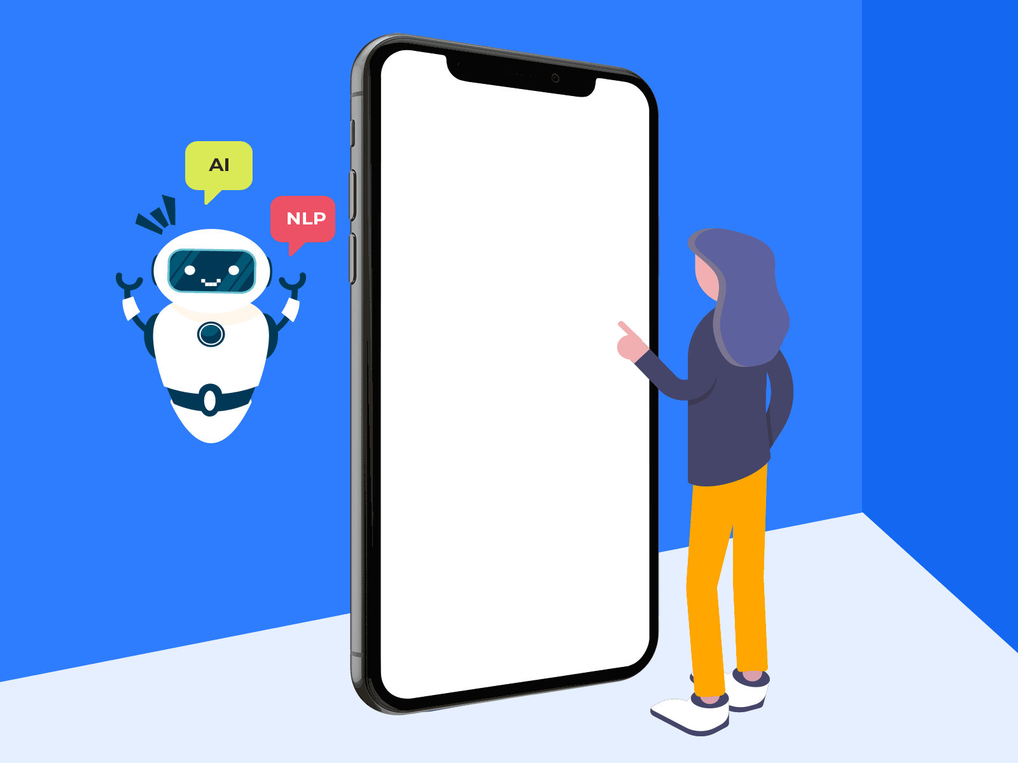

What is Chatbot ?
1. Chatbot is a software or computer program that simulates human conversation or ‘’chatter’’ through text or voice.
2. Users in both business-to-consumer (B2C) and business-to-business (B2B) environments increasingly use chatbot virtual assistants to handle simple tasks. Chatbot assistants are cost-effective, better utilize support staff time, and provide customer service when live agents are unavailable.

Slide 17


How does chatbot work?
For the bot to provide the right response, a unique pattern must be present in the database (blockchain all topics). Hierarchical structures can be built using various combinations of trends. Our algorithms reduce the number of classifications.

Slide 18

Bot Training?
Manual Training: Manual training entails the domain specialist compiling a list of commonly asked user questions and mapping out the answers. It enables the chatbot to identify the most relevant questions’ answers rapidly.
Automated Training: Automated training entails sending business documents to the chatbot, such as policy documents and other Q&A type documents, and instructing it to train itself. From these documents, the engine generates a list of questions and responses. The chatbot would then be able to respond with confidence.

Slide 19
Features of a chatbot !
24/7 Availability – Customers needn’t wait for the next available operator when chatbots are part of the communication strategy on a round-the-clock basis.
Instant Response – Chatbots can handle the queries of thousands of customers instantly as well as simultaneously and improve the average response time.
Consistency in Answers – The use of chatbots can help businesses maintain a great level of consistency in answers and improve customer experience with the brand.
Omni channel – AI-powered bots come with omnichannel messaging support features which help customers communicate with businesses through various channels such as websites, Facebook, etc.
Personalization – Bots can ensure a touch of personalization by engaging customers with one-on-one conversations, maintaining a natural-sounding tone, and being good at interactive communication.
Multilingual – Your business can program the sales bot to answer queries in the language of customers and expand the reach to new markets or territories.
Order without human help – Thanks to bots-driven automation, customers can book orders or do transactions without any human help.

Slide 20
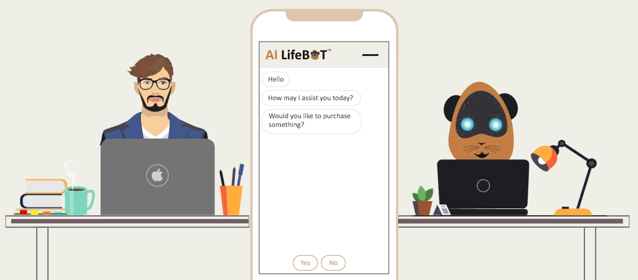
What Tools We’re Using ?
Python – A programming language used to build an architecture of our future chatbot
Pandas – A software library is written for the Python programming language for data manipulation and analysis
Twilio – Allows software developers to programmatically make and receive phone calls, send and receive text messages, and perform other communication functions using its web service APIs
TensorFlow – A library that is often used for the machine learning and neural networks tasks
SpaCy – An open-source software library for advanced natural language processing
Telegram, Viber, or Hangouts APIs – To connect chatbot to your messengers or websites

Slide 21

Testing and benefits?
Once the bot is ready, we start asking the questions that we taught the chatbot to answer. As usual, there are not that many scenarios to be checked so we can use manual testing. Testing helps to determine whether our AI NLP chatbot works properly. Artificial intelligence chatbots can attract more users, save time, and raise the status of your site. Therefore, the more users are attracted to your website, the more profit you will get.

Slide 22




Our Team
MEET OUR TEAM
Dr. Bappaditya Mondal
Subham Maity
Subhasish Negel
Bikram Debnath
14400119043
14400119039
Project Mentor
14400119044
14400119018
BTech CSE Student. Blockchain Enthusiast. Web3, MERN stack developer, Decentralized App Developer, and Smart Contract Writer
BTech CSE Student.
Data Science Enthusiast. data analyst, deep learning.
BTech CSE Student. Machine Learning Enthusiast. Natural Language Processing, Classification

Slide 23


